Slide 1
Mapping the 7

Slide 2
Introduction
Aim
Identify the right DXC (sub) offerings to meet the needs outline with the 2020 DXC 7 go forward major offerings
Approach
Use our existing assets (e.g. Sub-Offering Sales Guides from WWS)
Leverage the power of Digital Explorer

Slide 3
Working Datasets
Business Trend
The 7
Offering Family
Sub Offering Sales Guide
(From WWS)
Talking Points
FAQ
One pager
Technology Trend
Sub Offering Sales Guide
Sub Offering Sales Guide
Sub Offering Sales Guide
Sub Offering Sales Guide
Sub Offering Sales Guide
Workspace
Document

Slide 4
Notes
Workgroup name ‘DXC Offerings’
The 7 workspaces:
IT Mod
Offering workspaces:
Security SalesGuides
Cloud and Platform Services SalesGuides
Applications Services SalesGuides
BPS Salesguides
Workplace and Mobility Salesguides
Analytics SalesGuides
Within each SalesGuide Workspace each sub offering has an “attachment”

Slide 5
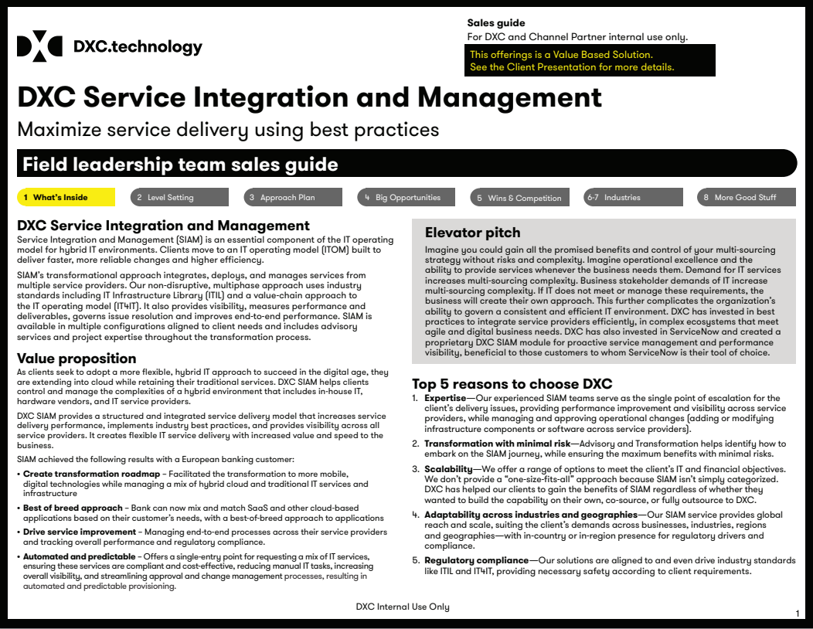
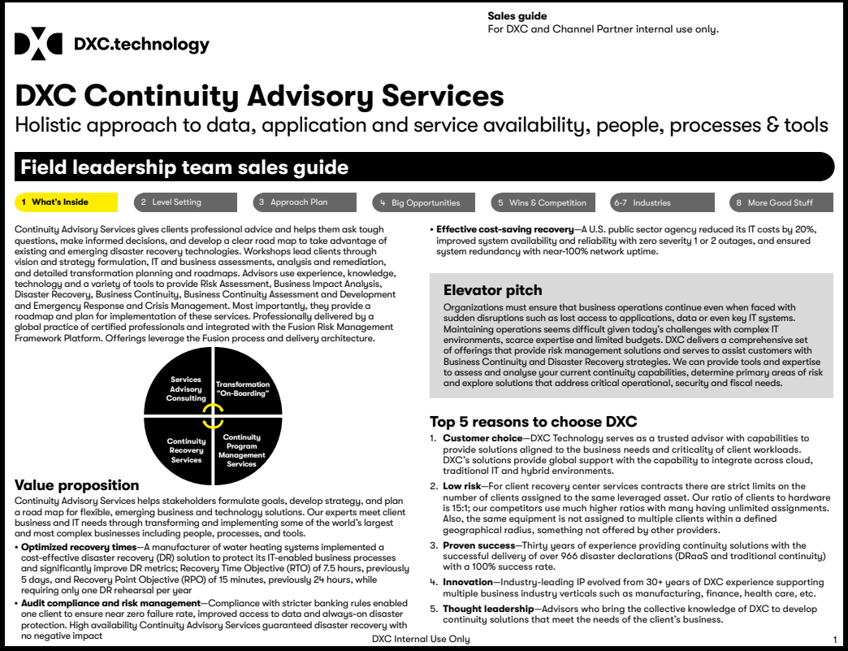
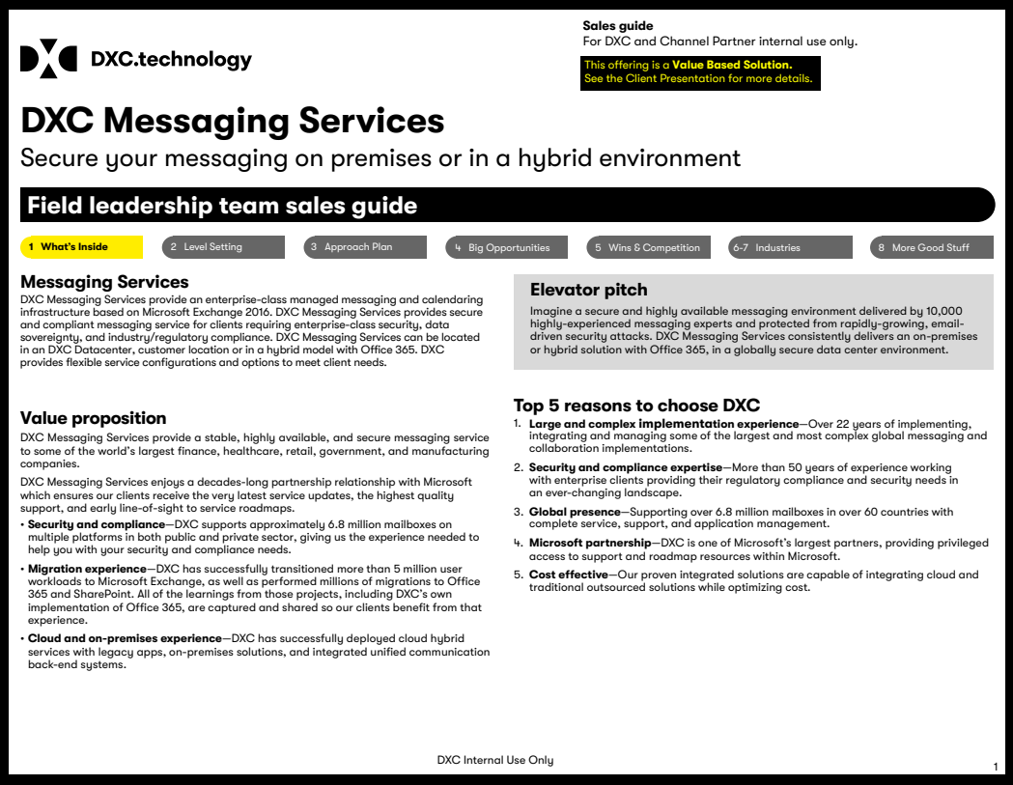
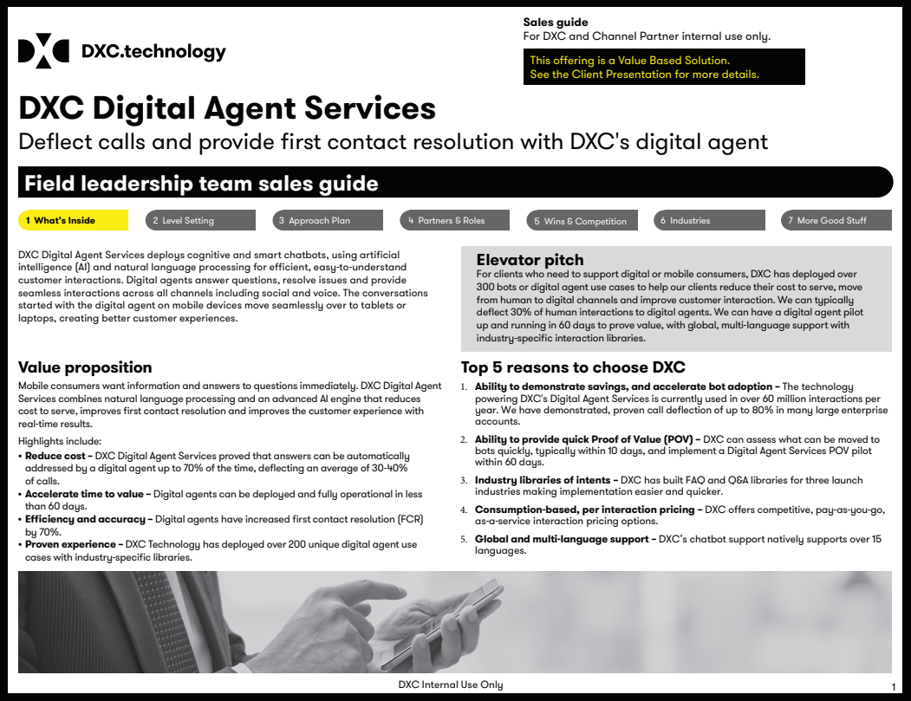
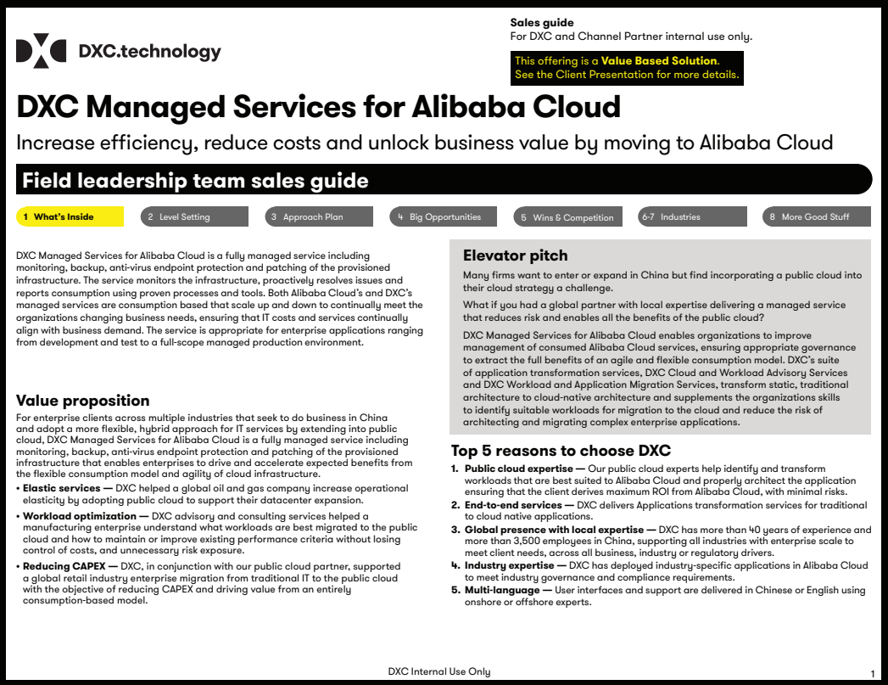
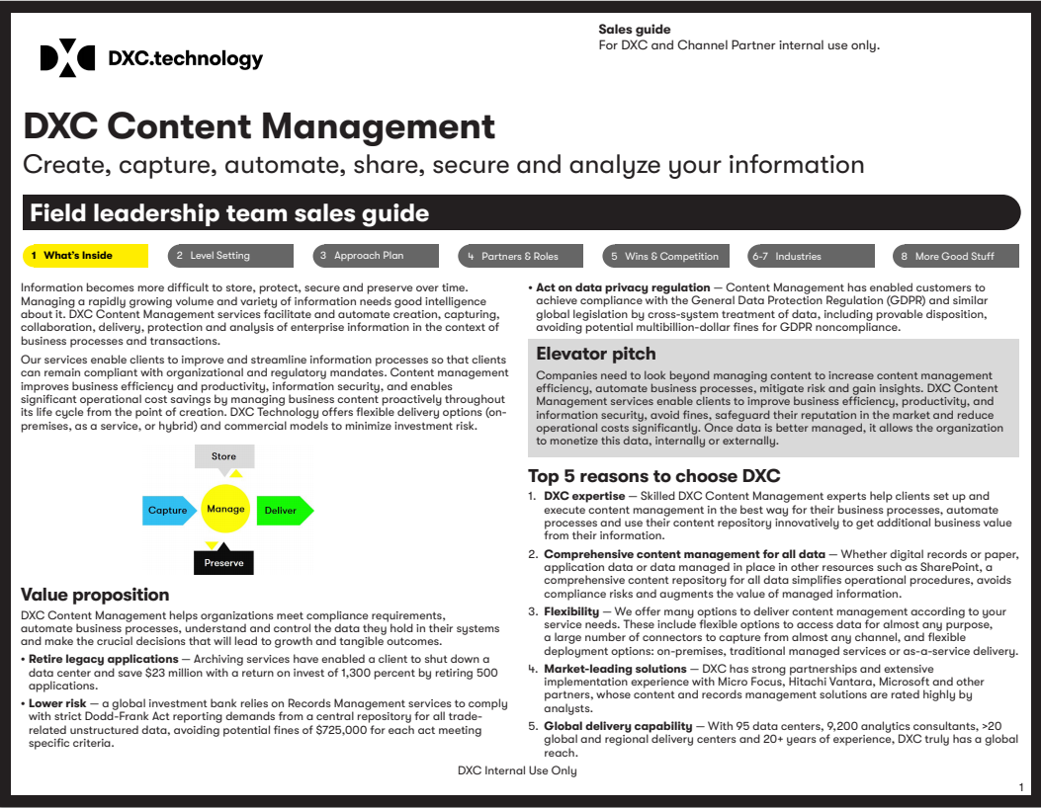

Slide 6
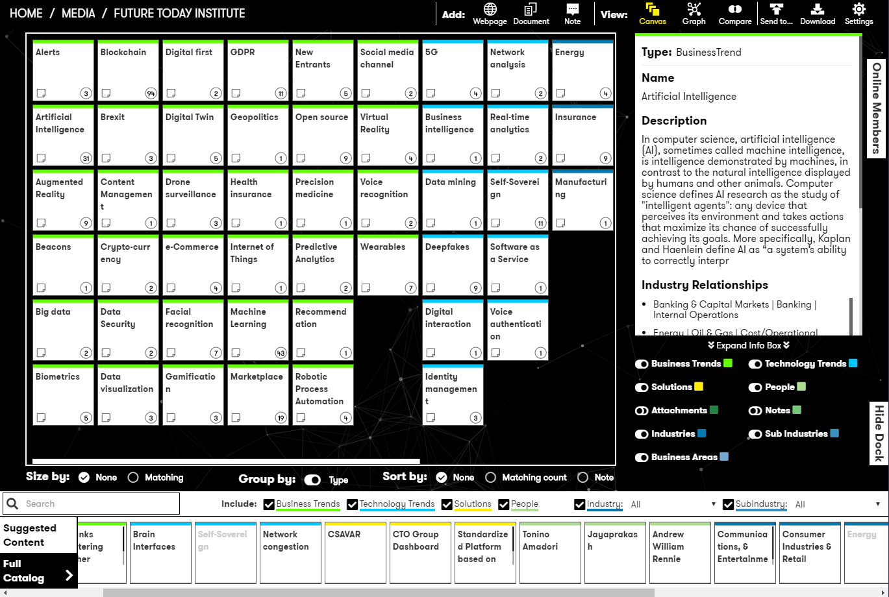

Industry
Sub Industry
Business Area
Business Trend
Technology Trend

Slide 7
Industry
Sub Industry
Business Area
Business Trend
Technology Trend

Slide 8
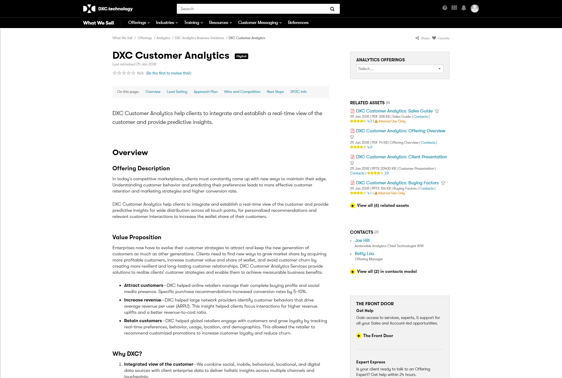
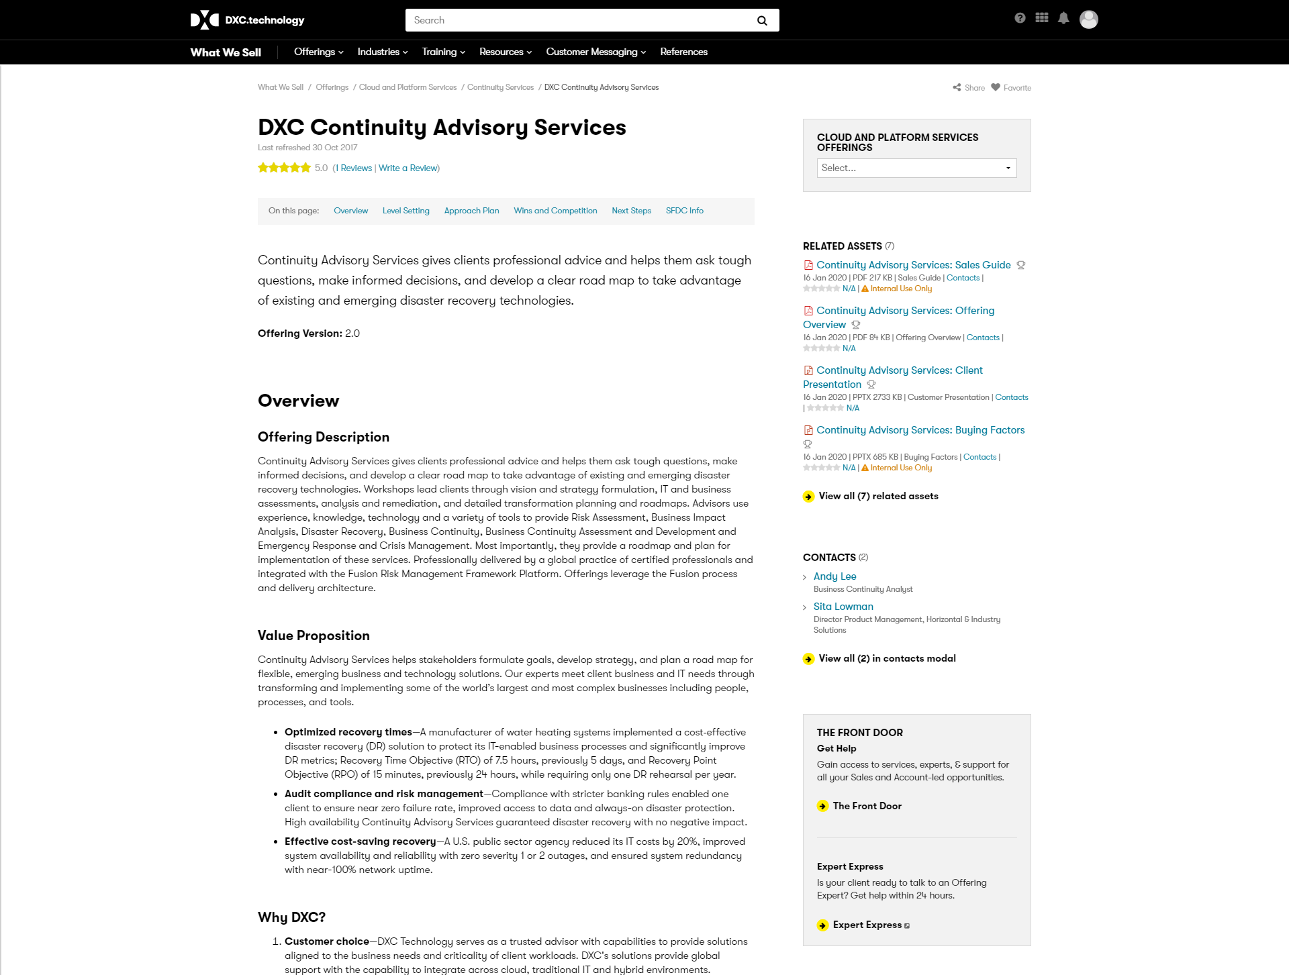

Slide 9
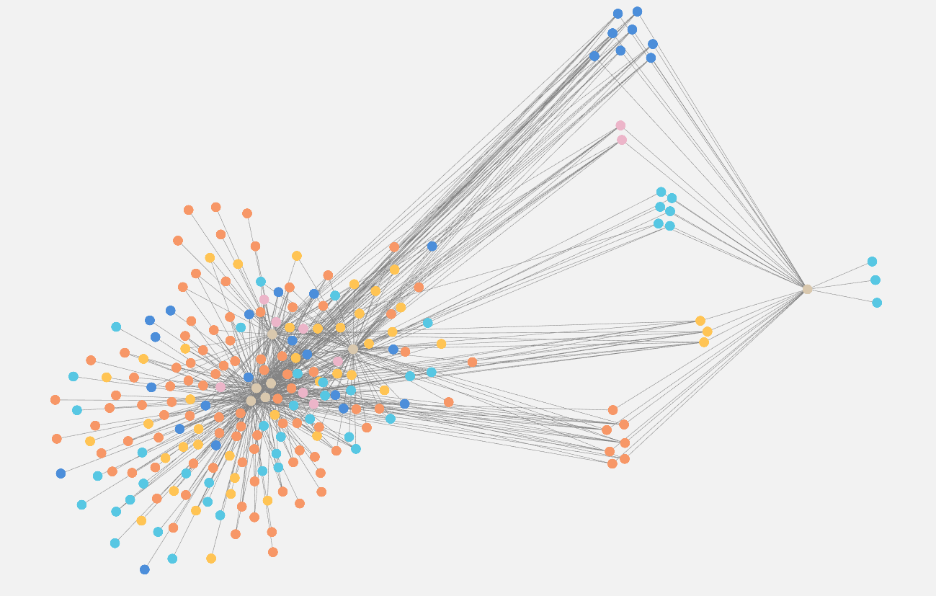
IT MOD MATERIAL
ALL THE SALES GUIDES

Slide 10
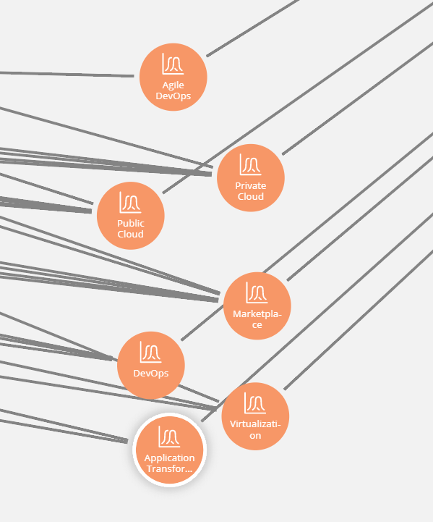
Common Business Trends

Slide 11
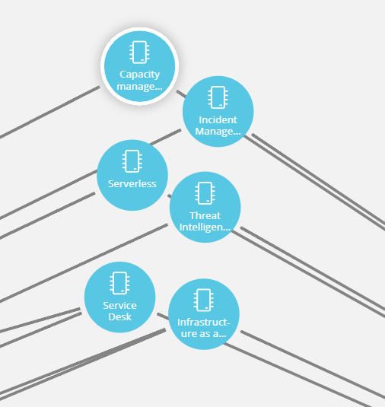
Common Technology Trends

Slide 12
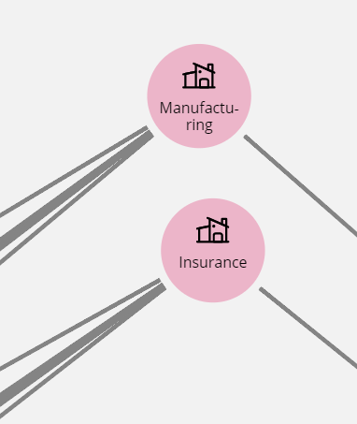
Key Industries

Slide 13
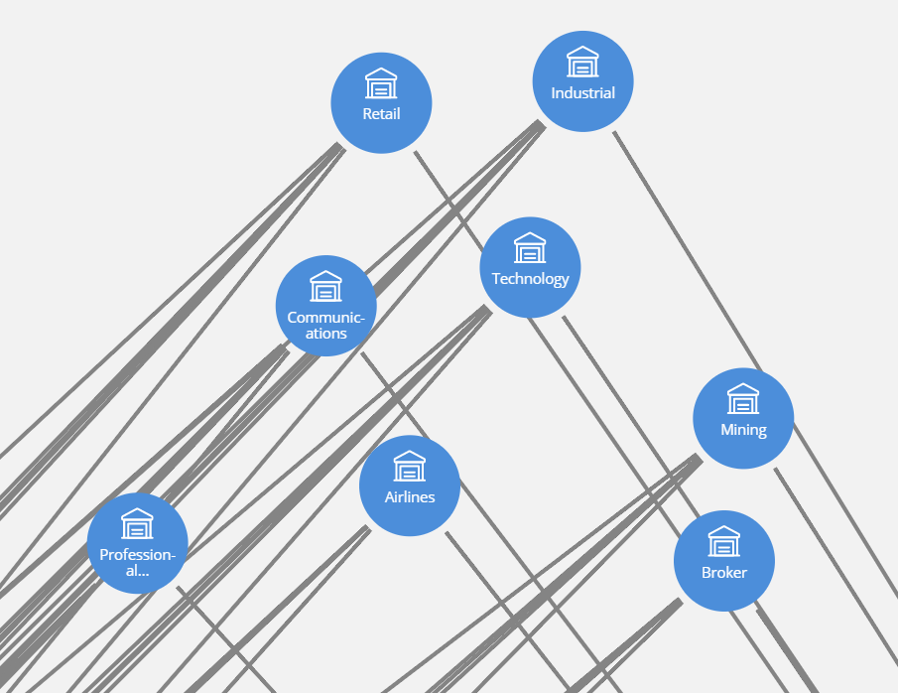
Key Sub Industries
Key Business Trends

Slide 14
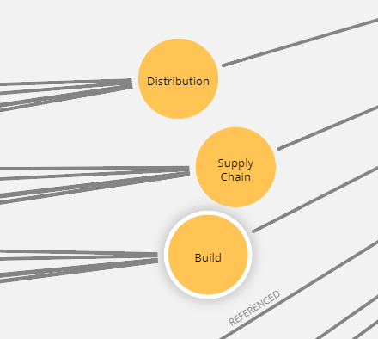
Key Business Areas

Slide 15
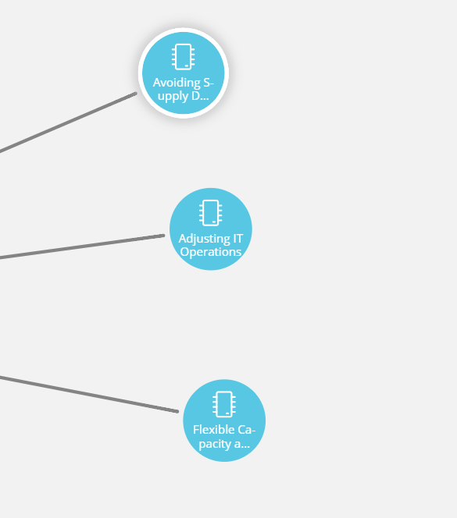
Unique technology trends within IT Mod

Slide 16
Sales Guide
Solution
Business Trends
Technology Trends

Slide 17
Sales Guide
Sub Offering DE Entry
Business Trends
Technology Trends

